Slide 1



Final Project GENG-8050-40
Data Analytics & Decision Making
Group 5 – July 22, 2023
Tejus Vivek-110095845
Zain Mohammad Beg-110124970
Ramzi Tabbara– 103782348
Sefiu Ibikunle-110122113
Yousuf Khan– 110125011
Syed Zaidi– 110104403

Slide 2

Agenda
Dataset Introduction
Problem Statement
Data Exploration
Develop Models
Assess Models
Diagnostics
Hypothesis Testing
Conclusion

Slide 3

Dataset Description
The dataset includes the combined used car information of 7 brands namely Audi, BMW, Skoda, Ford, Volkswagen, Toyota, and Hyundai containing information such as make, model, year, price, transmission, mileage, fuel type, miles per gallon (mpg), and engine size
The Data set is based on UK used car Market
No of Rows: 72207
No of Columns: 8

Slide 4

Problem Identification
The COVID-19 pandemic has had a significant impact on global supply chains, impacting new car production and delays in vehicles deliveries
This has led to an increase in car values in the used car market globally
Analysis of used car values data can be utilized in various scenarios
Car Dealerships
Buyers and Sellers
Market Researchers
Automotive Industry Professionals
Insurance Companies
Financing and Lending Institutions
Market Researchers
Academic Researchers

Slide 5
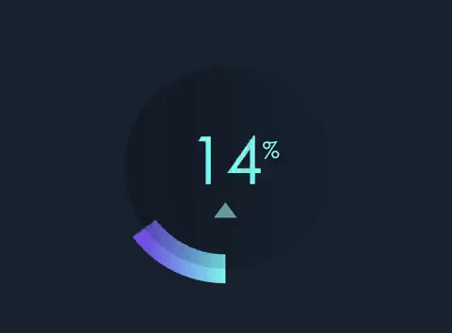
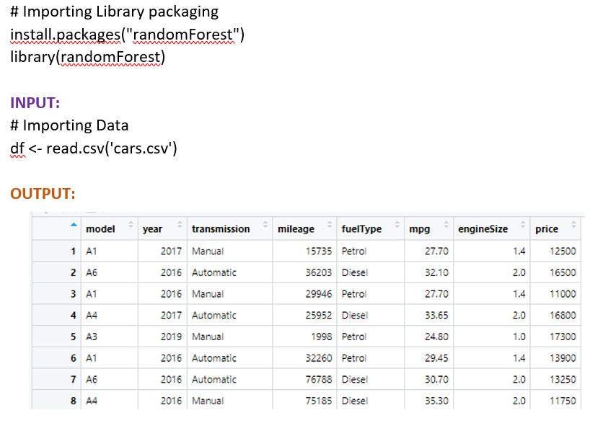
Data Exploration
Importing Library Packaging and Data

Slide 6

Data Exploration cont.
Variable Identification
Explanatory Variables
Mileage
Model year
MPG
Engine size
Response Variable
Price
Omitted Variables: Transmission Type, Fuel Type, Model

Slide 7
Data Modeling
Select 4 pairs of variables for modeling
Model Pair | Explanatory Variable | Response Variable
Model Pair 1 | Mileage | Market Price
Model Pair 2 | Model Year | Market Price
Model Pair 3 | MPG | Market Price
Model Pair 4 | Engine Size | Market Price

Slide 8
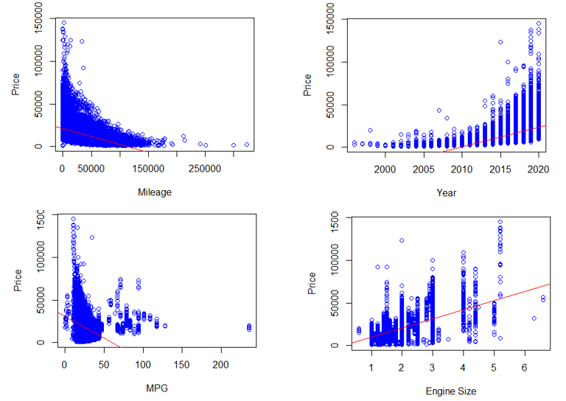
Data Visualization
INPUT:
plot(cars$mileage,cars$price, col = 'blue', xlab="Mileage", ylab="Price")
abline(model1, col = 'red')
plot(cars$year,cars$price, col = 'blue', xlab="Year", ylab="Price")
abline(model2, col = 'red')
plot(cars$engineSize,cars$price, col = 'blue', xlab="Engine Size", ylab="Price")
abline(model3, col = 'red')
plot(cars$mpg,cars$price, col = 'blue', xlab="MPG", ylab="Price")
abline(model4, col = 'red')
plot(cars$engineSize,cars$mpg, col = 'blue', xlab="engineSize", ylab="MPG")
abline(model4, col = 'red')
par(mfrow=c(2,2))
OUTPUT:
Mileage
Price
Year
Price
MPG
Price
Engine
Price

Slide 9
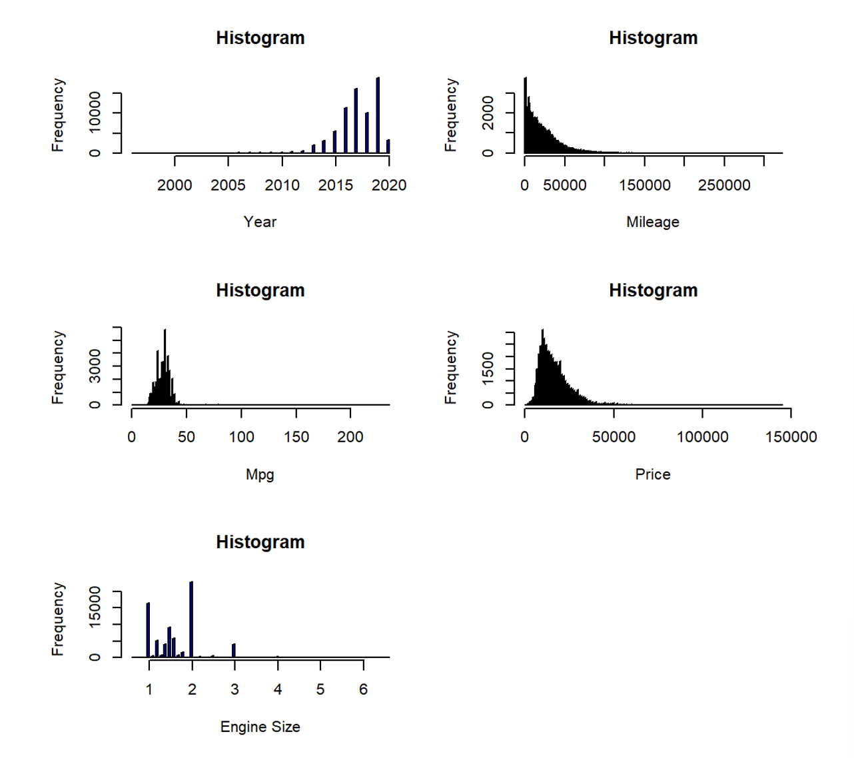
Data Visualization cont.
INPUT:
hist(cars$year, breaks = "FD", col = "blue", main = “Histogram", xlab = "Year")
hist(cars$mileage, breaks = "FD", col = "blue", main = “Histogram", xlab = "Mileage")
hist(cars$mpg, breaks = "FD", col = "blue", main = " Histogram ", xlab = "Mpg")
hist(cars$price, breaks = "FD", col = "blue", main = " Histogram ", xlab = "Price")
hist(cars$engineSize, breaks = "FD", col = "blue", main = " Histogram ", xlab = "Engine Size")
OUTPUT:

Slide 10
Model Pair 1 Linear Regression Model & Equation
INPUT:
Explanatory Variable: Mileage
Response Variable: Price
SUMMARY:
R-Squared Value of 0.18
Y=mx+b
Price = – 0.1859*Mileage + 20890
# Create the linear model for model pair 1
model1 <- lm(df$price ~ df$mileage, data=df)
predicted_values_model1<- predict(model1)
model1_residuals <- residuals(model1)
summary(model1)
OUTPUT:

Slide 11
Model Pair 2 Linear Regression Model & Equation
INPUT:
Explanatory Variable: Year
Response Variable: Price
SUMMARY:
R-Squared Value of 0.27
Y=mx+b
Price = 2.298e+03*year -4.619e+06
# Create the linear model for model pair 2
model2 <- lm(df$price ~ df$year, data=df)
predicted_values_model2<- predict(model2)
model2_residuals <- residuals(model2)
summary(model2)
OUTPUT:

Slide 12
Model Pair 3 Linear Regression Model & Equation
INPUT:
Explanatory Variable: MPG
Response Variable: Price
SUMMARY:
R-Squared Value of 0.1588
Y=mx+b
price = - 511.626*mpg + 30814.18
# Create the linear model for model pair 3
model3 <- lm(df$price ~ df$mpg, data=df)
predicted_values_model3 <- predict(model3)
model3_residuals <- residuals(model3)
summary(model3)
OUTPUT:

Slide 13
Model Pair 4 Linear Regression Model & Equation
INPUT:
Explanatory Variable: Engine Size
Response Variable: Price
SUMMARY:
R-Squared Value of 0.41
Y=mx+b
Price = 10728.23*engineSize - 1026.81
# Create the linear model for model pair 4
model4 <- lm(df$price ~ df$engineSize, data=df)
predicted_values_model4 <- predict(model4)
model4_residuals <- residuals(model4)
summary(model4)
OUTPUT:

Slide 14
Model Assessment
Highest R-squared value is Model Pair 4
Engine Size has the highest impact on price of the car
Predictor of price: Pair 4 > Pair 2 > Pair 1 > Pair 3 based on the assessment of R-squared value.
Model Pair | Explanatory Variable | Response Variable | R-squared value
Model Pair 1 | Mileage | Market Price | 0.18
Model Pair 2 | Model Year | Market Price | 0.27
Model Pair 3 | MPG | Market Price | 0.16
Model Pair 4 | Engine Size | Market Price | 0.41

Slide 15

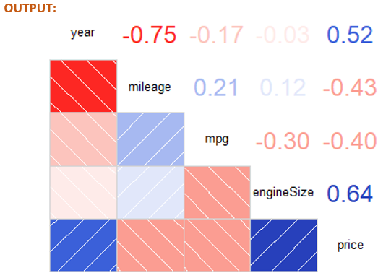
Model Assessment cont.
install.packages("corrgram")
library("corrgram")
cor(df$price, df$mileage)
cor(df$price, df$year)
cor(df$price, df$mpg)
cor(df$price, df$engineSize)
corrgram(df, lower.panel=panel.shade, upper.panel=panel.cor)
Of the four explanatory variables, Engine Size has the highest correlation to price with a value of 0.64, followed by year which has a correlation value of 0.52.

Slide 16
Model Selection
Model Pair | Explanatory Variable | Response Variable | R-squared value
Model Pair 1 | Mileage | Market Price | 0.18
Model Pair 2 | Model Year | Market Price | 0.27
Model Pair 3 | MPG | Market Price | 0.16
Model Pair 4 | Engine Size | Market Price | 0.41
Based on R-squared and correlation coefficient, Model Pair #4 was selected (Engine Size)
Despite the Engine Size (model pair 4) being chosen as the highest contributor, it does not end up being the model pair chosen in the end.

Slide 17
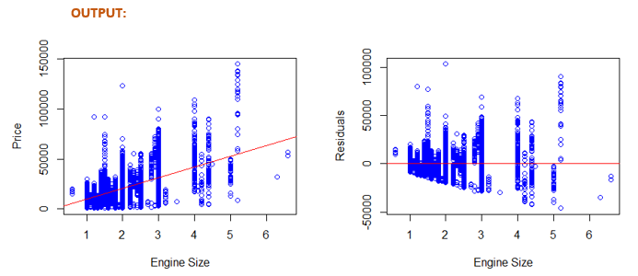
Model Diagnostics - Linearity Check
Scatter plot (Exp vs Resp Variables)
The relationship between the explanatory and response variable is low to moderately linear
Scatter plot (Residuals)
The residuals are not distributed equally along the 0 line.
No linear pattern observed.
Cannot accurately predict the price of used cars.

Slide 18
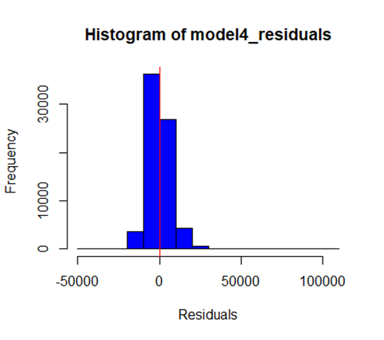
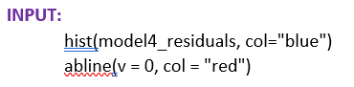

Model Diagnostics – Nearly Normal Check
Nearly Normal Check
Histogram of residuals display a nearly normal distribution.
As a result, the requirement of nearly normal residuals is satisfied.

Slide 19
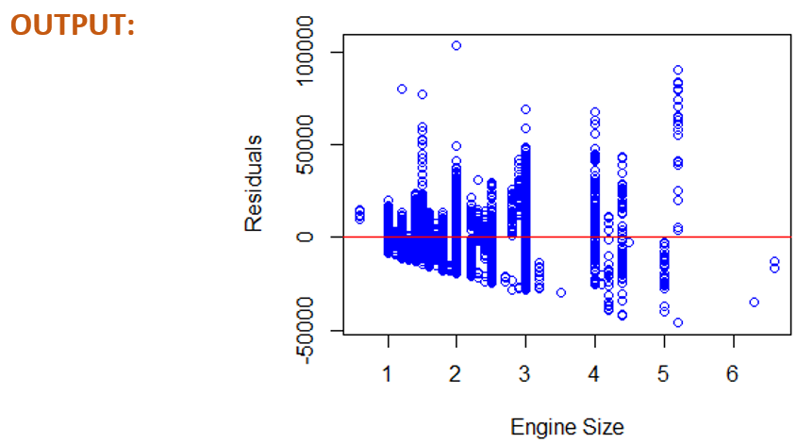
Model Diagnostics – Constant Variability
Constant Variability Check
Residuals are not uniformly and continuously centered around the y=0 line.
Apparent funnel pattern forming.
The requirement of constant variability has not been satisfied
INPUT:
plot(df$engineSize, model4_residuals, col="blue",xlab = "Engine Size", ylab= "Residuals")
abline(h=0, col='red')

Slide 20
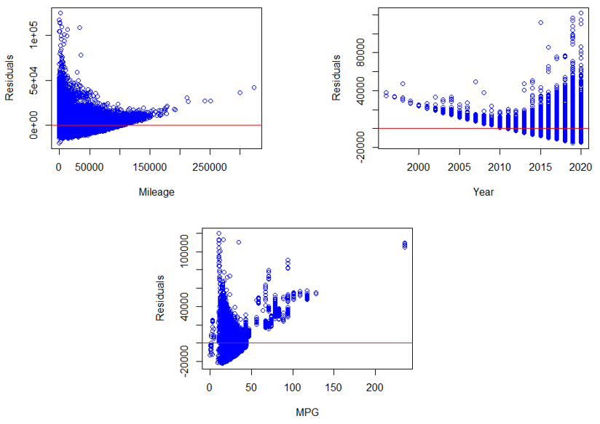
Model Re-assessment
Since constant variability was not met for Model Pair #4 (engine size,) we plotted the other three variables to check variability, however they too did not pass.
INPUT:
plot(df$mileage, model1_residuals, col="blue",xlab = "Mileage", ylab= "Residuals")
abline(h=0, col='red’)
plot(df$year, model2_residuals, col="blue",xlab = "Year", ylab= "Residuals")
abline(h=0, col='red’)
plot(df$mpg, model3_residuals, col="blue",xlab = "MPG", ylab= "Residuals")
abline(h=0, col='red')

Slide 21
Model Re-assessment
Since all 4 models failed the constant variability diagnostic check, it was necessary to transform the data.
To increase variability, normality, reduce skewness, and increase symmetry the team chose to scale the explanatory and response variables using a logarithmic function to base 10.
INPUT:
#Transformed model 1
transformed_explanatory1 <- log10(df$mileage)
transformed_response <- log10(df$price)
model1 <- lm(transformed_response ~ transformed_explanatory1, data=df)
summary(model1)
#Transformed model 2
transformed_explanatory2 <- log10(df$year)
transformed_response <- log10(df$price)
model2 <- lm(transformed_response ~ transformed_explanatory2, data=df)
summary(model2)
#Transformed model 3
transformed_explanatory3 <- log10(df$mpg)
transformed_response <- log10(df$price)
model3 <- lm(transformed_response ~ transformed_explanatory3, data=df)
summary(model3)
#Transformed model 4
transformed_explanatory4 <- log10(df$engineSize)
transformed_response <- log10(df$price)
model4 <- lm(transformed_response ~ transformed_explanatory4,data=df)
summary(model4)
Model Pair | Explanatory Variable | Response Variable | R-squared value | Transformed R-squared
Model Pair 1 | Mileage | Market Price | 0.18 | 0.22
Model Pair 2 | Model Year | Market Price | 0.27 | 0.42
Model Pair 3 | MPG | Market Price | 0.16 | 0.21
Model Pair 4 | Engine Size | Market Price | 0.41 | 0.34
The new selected pair is Model Year

Slide 22
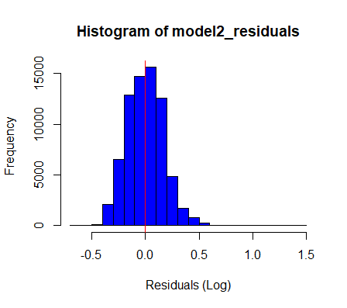
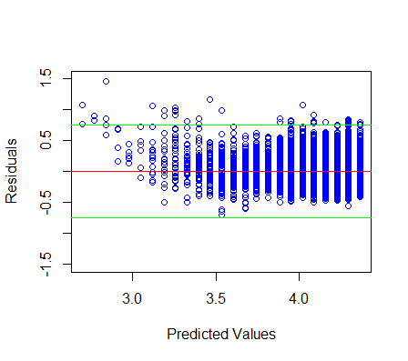
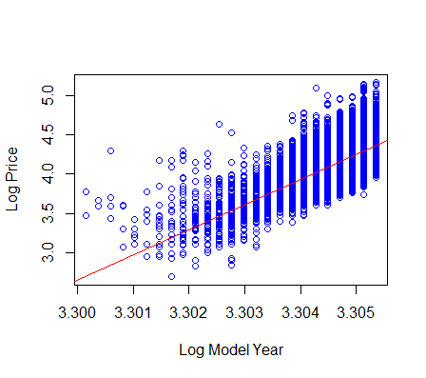

Reassessing Model Diagnostics
Assessing Model Pair 2 using the transformed data, the model passes all of the checks
Scaling the data allowed for the statistical techniques to work
Linearity
Nearly Normal
Constant Variability

Slide 23
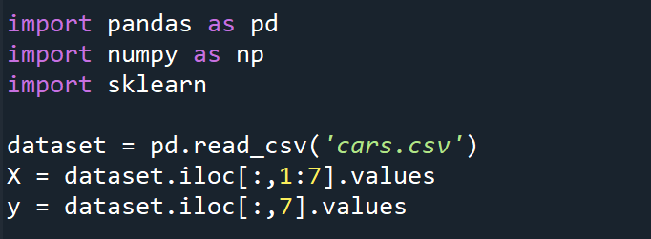
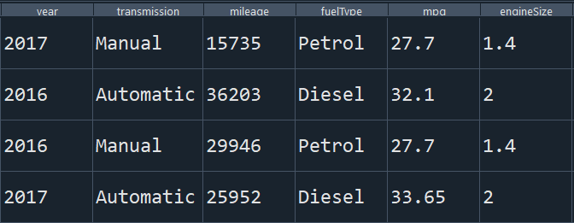
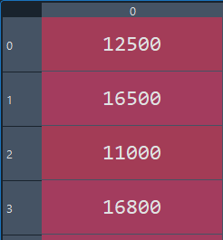
Random Forest Regression (Using Python)
Importing the Dataset
Import the Data Set
Split Dataset into Explanatory and Response variable.
Considers 6 Explanatory Variables
X (Explanatory Variables)
Y (Response Variable)

Slide 24
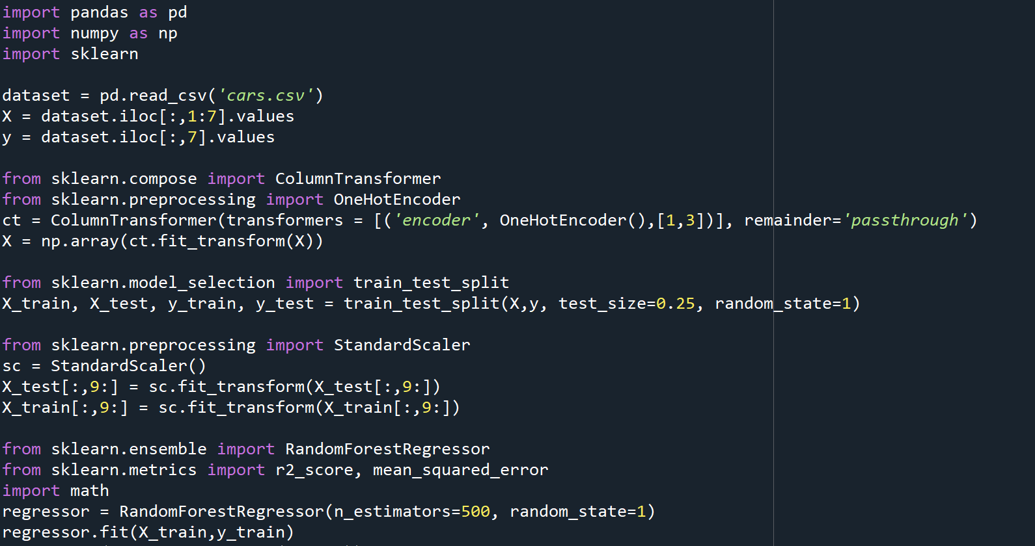
Random Forest Regression (Using Python)
Encode the Categorical Data – Fuel Type, Transmission Type
Split into 75:25 train-test split
Scale the remaining columns to a comparable value
Create a Random Forest Regression Model

Slide 25
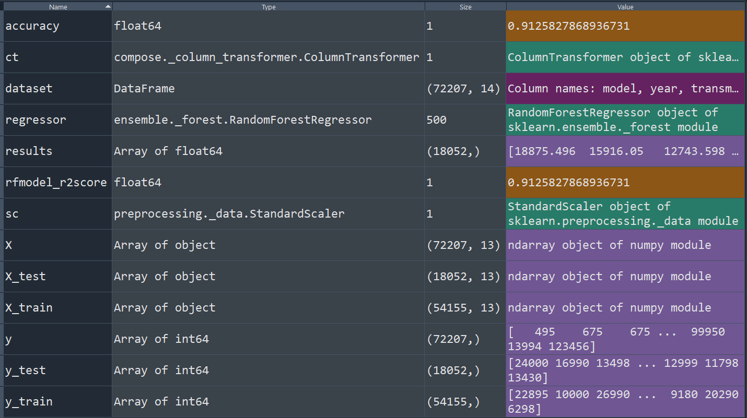
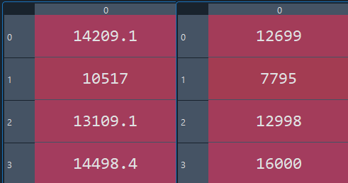
Results (Using Python)
Results
Predicted
Actual

Slide 26

Hypothesis Testing
Question: Cars <=2017MY are priced equal to or less than the average price of used cars from the population of vehicles within the dataset.
Knowns:
Sample size (n) = 39853 (Number of samples with model year <= 2017)
Hypothesized mean (μ0) = 16576.49 (Population price mean for dataset)
Hypothesis:
H0 = μ > 16576.22 (Null Hypothesis)
Ha = μ ≤ 16576.22 (Alternative Hypothesis)
Calculation:
x̄ = 12562.58 (Sample mean – used excel)
σ = 9296.509 (Sample Standard Deviation – used excel)
SE = SE= σ /√n = 46.56819282 (Standard Error)
Z = (x̄-μ)/SE = -86.19409346
Critical Z value = Z0 = -1.645 (From Z-table)
Result
Since Z < Z₀ , we reject the Null Hypothesis as the data provides enough evidence to support the claim that the cars of Model year 2017 or earlier are priced equal to or less than the average price of used cars from the population of vehicles within the dataset.

Slide 27

Conclusion
Difficult to predict the price of a used car with just one predictor
Linear Regression showed Engine size has the highest correlation to the price, but failed model diagnostics
Scaling data using log10 made the dataset less skewed and more symmetric
Scaled data showed Model Year as best predictor
Multiple variable Random Forest Regression Model (Python) proved more accurate
In summary, Model Year is the best predictor of price , but Transmission Type, Mileage, Fuel Type, MPG, and Engine Size need to be considered

Slide 28

Q&A

